Slide 1
Swarm Intelligence
Learning to be intelligent from the less intelligent

Slide 2
Social Behavior
Social behavior is an important attribute in the human society
Collective intelligence .
Prominent in other life forms.
Collective communication ,experiences of the fellow organisms, an individual entity of the system organizes and leads towards the result.

Slide 3
Swarm Intelligence
Swarm intelligence is the discipline that deals with natural and artificial systems composed of many individuals that coordinate using decentralized control and self-organization
Bird Flocks, Fish Schools display such a structural order.
Decentralized control. Ex: ants , bees.
Inspired from the behavior of social insects and flocking animals

Slide 4
Swarm Intelligence
It makes an attempt to explain the emergent biological phenomenon tasks .
ex: a. Crowd modeling
b. Military History
c. Variants in Social Science.
Agent-based modeling
Self Organizing System.

Slide 5
Swarm Characteristics
Homogeneity: Every member in the group has the same behavioral model.Though the group seems to lack a leader, temporal leader seem to appear.
Locality: The motion of each member of the group is only influenced by its nearest flock or group member. Vision is considered as primary tool.
Collision Avoidance: Avoid collision with nearby flock mates.
Velocity Matching: attempt to match velocity with nearby flock mates.
Flock Centering: attempt to stay close to nearby flock mates

Slide 6
Swarm Behaviors
Swarm : an aggregate with cohesion, but a low level of polarization (parallel alignment) among members
Torus: individuals perpetually rotate around an empty core (milling). The direction of rotation is random.
Dynamic parallel group: the individuals are polarized and move as a coherent group, but individuals can move throughout the group and density and group form can fluctuate.
Highly parallel group: much more static in terms of exchange of spatial positions within the group than the dynamic parallel group and the variation in density and form is minimal.

Slide 7
Swarm AI Principles in Simulating Flock Behavior
Principle 1: Create a system of agents that work individually on a common problem.
Principle 2: Agents are simple, fast, and have a limited perspective
Principle 3: Indirect Simple Inter-Agent Communication

Slide 8
Ant Colony Optimization (ACO)
Ants achieve complex targets efficiently.
The process of communication between the ants is also quite fascinating.
These characteristics are vastly useful in various areas like wireless networks, robotics where communication between the entities is necessary to achieve the required goals.

Slide 9
Features
It is easy to implement.
It is a generic algorithm that works for any optimization problem that can be formulated in terms of an objective function.
There are mathematical proofs that it converges on the exact solution for some problems.
It is faster than other approximate methods for solving optimization problems.

Slide 10
Particle Swarm Optimization
Particle Swarm was introduced to simulate social interactions.
Individuals can obtain evolutionary advantage by sharing information.
A stripped-down version of the model was presented as a novel and generic optimization technique, the Particle Swarm Optimizer (PSO).
Personal experience and Neighbors‘ experience are the special features

Slide 11
Imparting Swarm Intelligence
“Choice of a research domain for imparting swarm concepts”
Wireless networking domain consisting of thousands of systems that are distributed throughout a wide geographical area
Ant Colony Optimization technique is more suitable as both the instances are similar in characteristics.
Classification problem

Slide 12
Iris data Classification
Iris data set is a multivariate data set introduced by Sir Ronald Aylmer Fisher to describe discriminant analysis.
The iris data set is the collection of 50 samples each of three plant species namely Iris Setosa, Iris Versicolor and Iris Verginica.
Based upon the given plant’s sepal and petal lengths and widths, it should be classified into one of the three species
.The present problem is now extended to the neural network swarm classification

Slide 13
“Characterizing the swarm particles”
All the particles are created alike and behave in the same fashion following Homogeneity.
Locality may induce more complexity into the approach rather than extracting more efficiency. However, Locality may induce more complexity into the approach rather than extracting more efficiency.

Slide 14
All the particles are working in the same weight space, no particle is hindering the weight adjustment of the neighbors, thus obeying the characteristic avoiding Collision Avoidance.
Velocity Matching is controlled by the learning factor.
Flock Centering is aptly followed in view of the constrained weight search space.

Slide 15
The set of weights for the neural network here constitute a swarm particle.
Fitness criterion: Classification error.
Particle is initialized with capability to sense better weights that can reduce the error of classification in its vicinity.

Slide 16
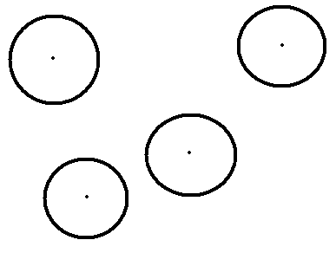
Fig 1: Characterization of swarm particles
The dot in the circle can be depicted as an ant whose pheromone sensing capability range can be seen in the form of the circle.

Slide 17
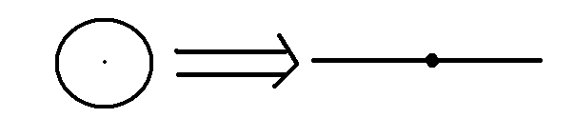
Fig 2: Transformation depicting swarm particles for the one dimensional weight adjustment.

Slide 18


The fitness decides the global leader in accordance with which the other particles adjust their movement
The global leader may not be the same particle throughout the course of search
(a)
(b)
Fig 3 Instance of swarm interaction

Slide 19
If the swarms are blindly directed towards the best particle, there is a chance that the problem may converge at the local maxima. For instance, consider a particular example in the previous example. Let us suppose that the particles are generated a shown in the Fig. 3(a).
The two particles are generated such that one is at local maximum (b) and the other at a point close to the global maximum (a).If the best particle alone influences all the particles to adjust their movement, the particle at ‘a’ is now forced to move towards the point ‘b’(Fig 3(b)). Thus, it moves away from the global maximum. This may lead to wrong solutions. Thus, the swarm particles should not solely depend on the best particle but also should value its judgment in its environment.

Slide 20
Results and Discussion
The swarm intelligence approach maximizes the efficiency to find the best possible weights for the neural network for solving Iris data problem.
The swarm intelligence approach used in this research uses a learning factor that can be varied to converge the classification problem.
The number of swarm iterations is found to be decreased by increasing the swarm learning factor from 0.05 to 0.6.
The number of iterations in which the problem converges is approximately 5 and thus is more efficient than Genetic algorithm and back propagation algorithm for the iris data problem.

